Slide 1
Training App
Team 5:
Hamed Amokrane Ould Hamou
Rico Thompson
Jimmy Tran
David Zheng

Slide 2

The Idea
Personally training new employees at a restaurant can be time-consuming
Even trained employees can forget things occasionally
Managers need a way to train and/or remind employees of proper procedures

Slide 3
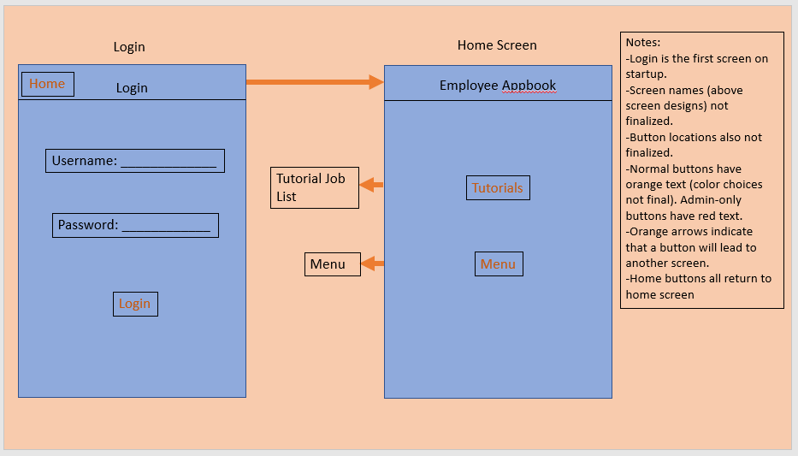
Storyboard

Slide 4
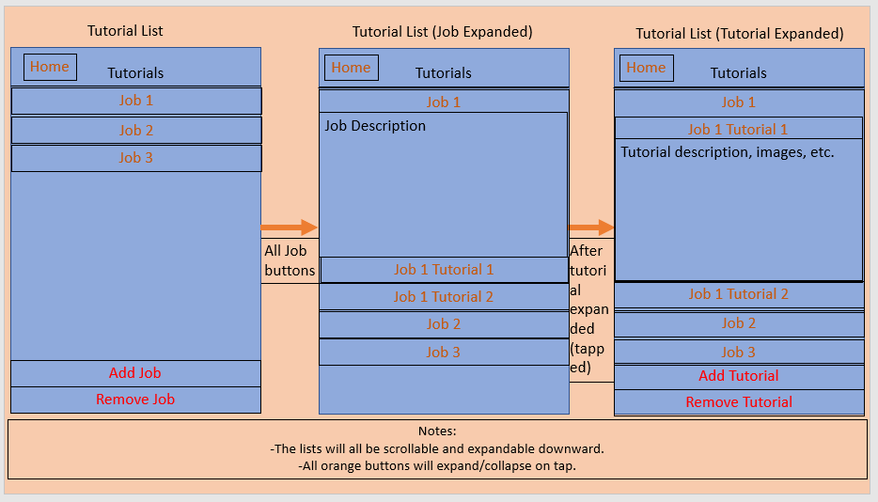
Storyboard

Slide 5
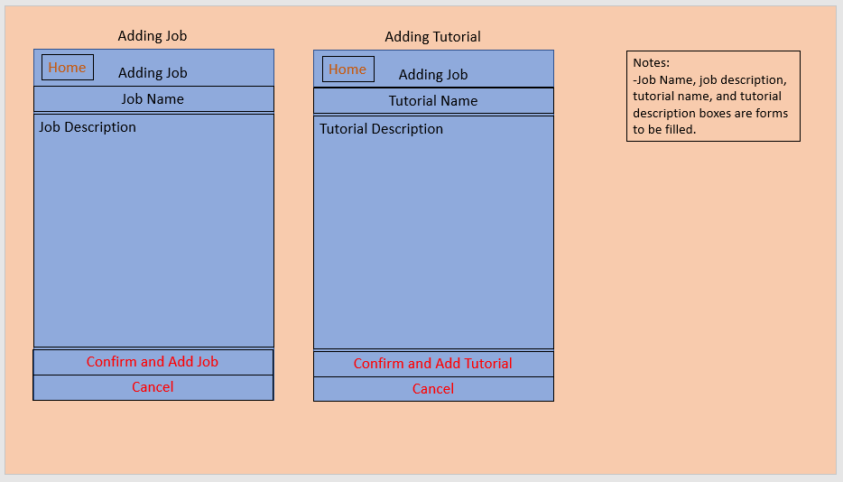
Storyboard

Slide 6
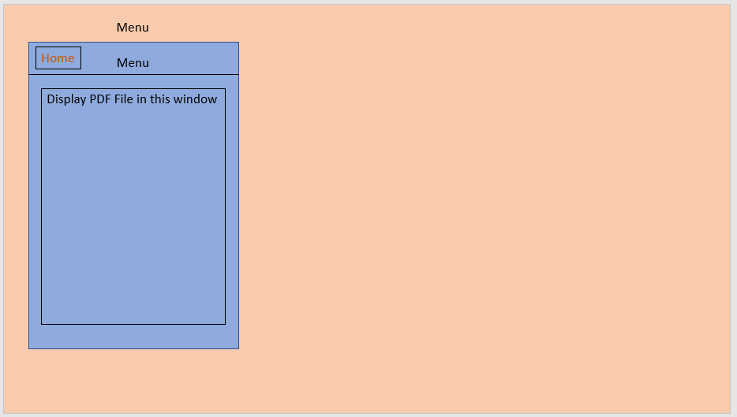
Storyboard

Slide 7
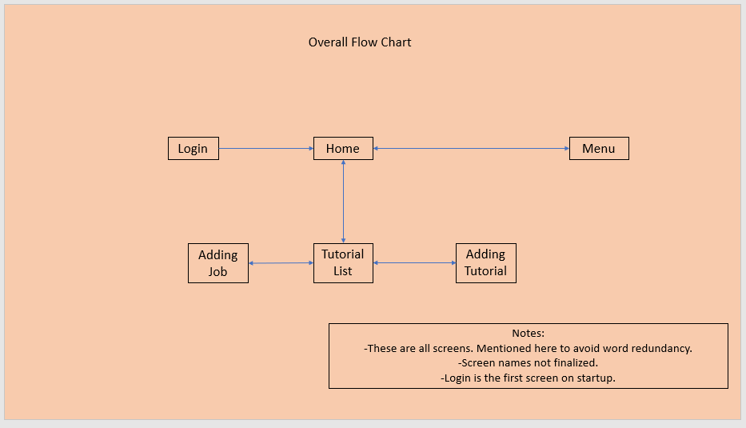
Storyboard – Flow Chart

Slide 8
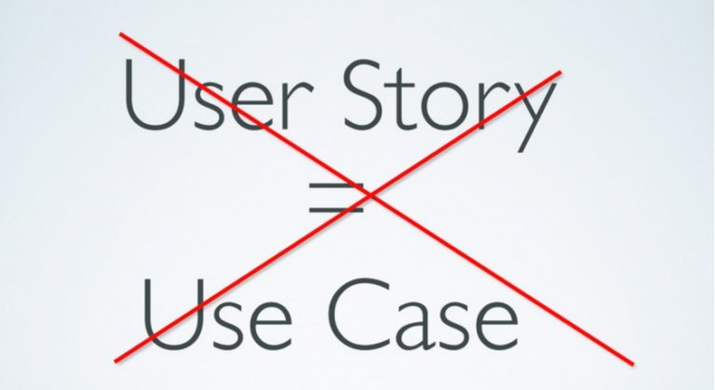
Use Cases
Implemented:
Requirement #1: Open Menu
Requirement #2: Open Tutorials
Requirement #3: Select Job
Requirement #4: Select Tutorial
Not Implemented:
Requirement #5: Add Job
Requirement #6: Remove Job
Requirement #7: Add Tutorial
Requirement #8: Remove Tutorial

Slide 9
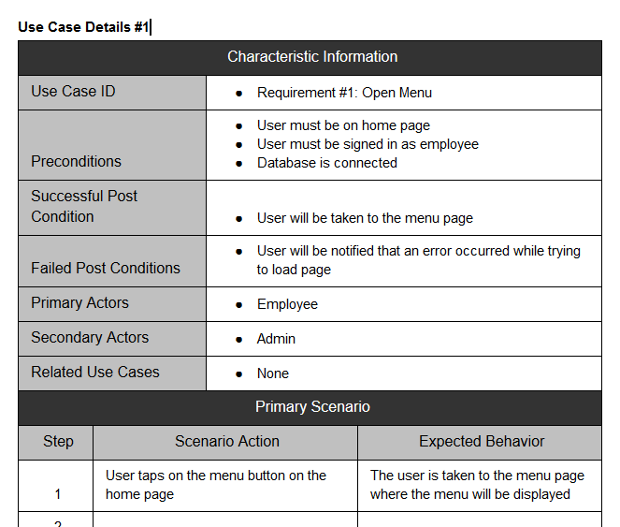
Use Case #1
User taps on the menu button
Menu opens

Slide 10
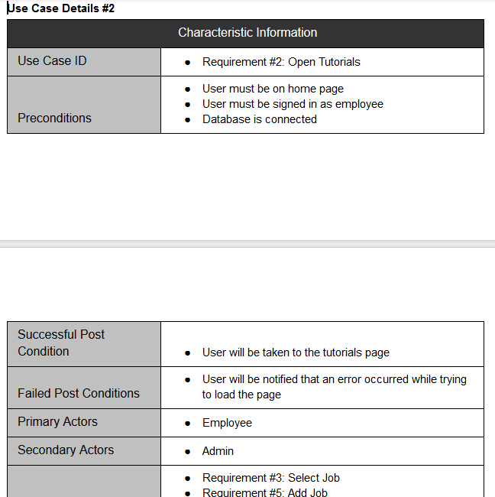
Use Case #2
User taps on the tutorials button
Tutorial list opens

Slide 11
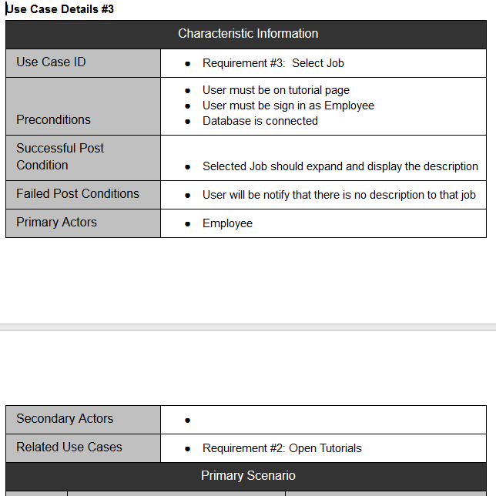
Use Case #3
User taps on a job
Job expands and shows:
Description
Tutorials for that job

Slide 12
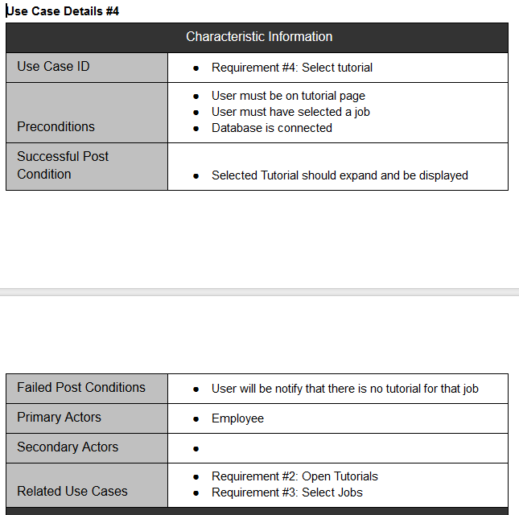
Use Case #4
User taps on a tutorial
Tutorial expands with description

Slide 13
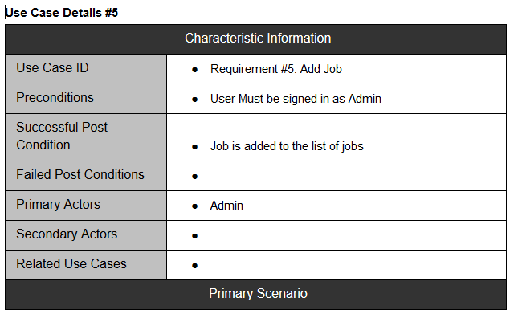
Use Case #5
Admin presses the add job button
Allows additional jobs to be added
Not implemented – yet.

Slide 14
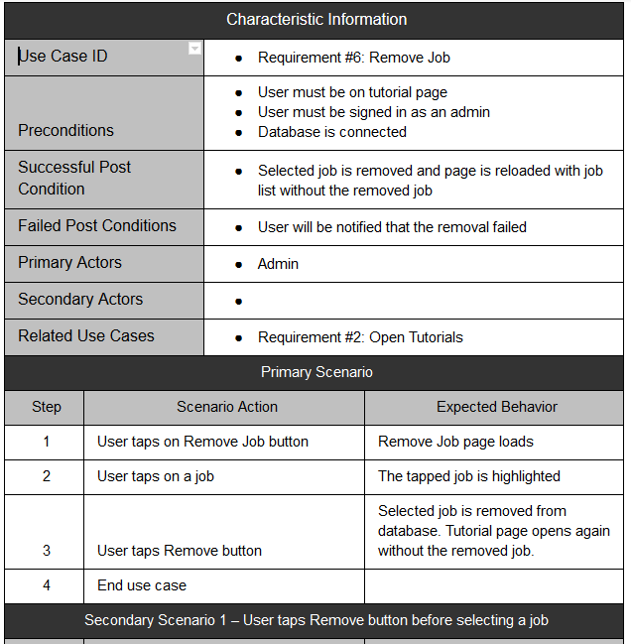
Use Case #6
Admin presses the remove job button
Allows jobs to be removed
Not implemented – yet.

Slide 15
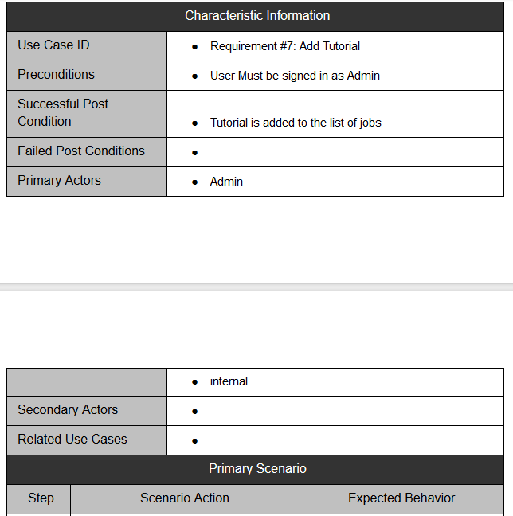
Use Case #7
Admin presses the add tutorial button
Allows additional tutorials to be added
Not implemented – yet.

Slide 16
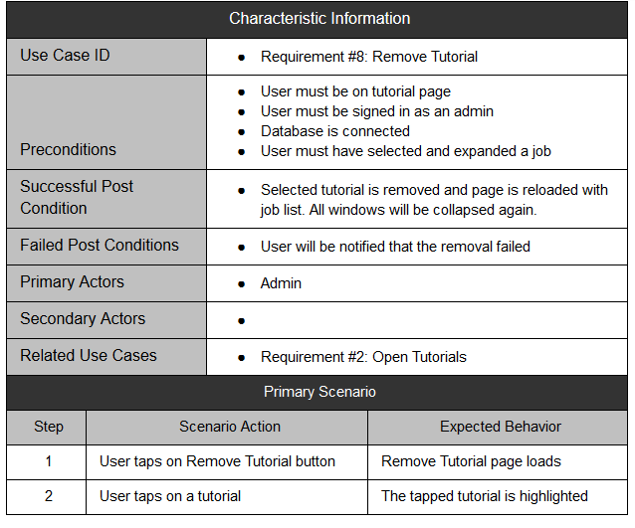
Use Case #8
Admin presses the remove tutorial button
Allows tutorials to be removed
Not implemented – yet.

Slide 17
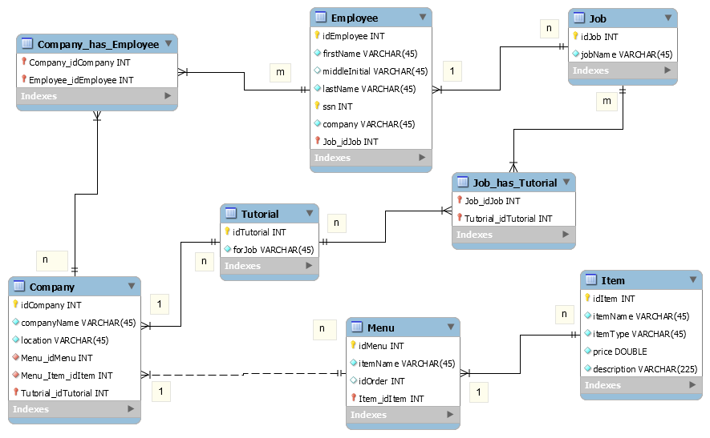
Data Model (Old)

Slide 18
Demo Time!

